Slide 1
LESSON 9.2
Enthalpies of Formation & Combustion

Slide 2
LESSON GOALS
I can calculate ΔH of a reaction or deduce equations and solutions to problems using standard enthalpies of formation or combustion

Slide 3
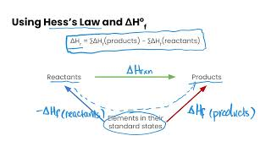
TASK 1: LEARN (MUST DO)
Watch the Enthalpy Changes of Formation video
Complete the appropriate section of the guided note

Slide 4
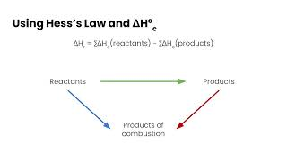
TASK 2: LEARN (MUST DO)
Watch the Enthalpy Changes of Combustion video
Complete the appropriate section of the guided note

Slide 5
TASK 3: PRACTICE
Complete the enthalpies of formation & combustion practice (answers included)
Note: There are must do, should do, and aspire to do questions included in this practice!

Slide 6
TASK 4: MASTERY CHECK (MUST DO)
Complete the enthalpies of formation & combustion mastery check (see me when you are ready!)

